Slide 1
Random Effects

Slide 2
Overview
Centering
Multiple sources of variation
Tests/contrasts

Slide 3
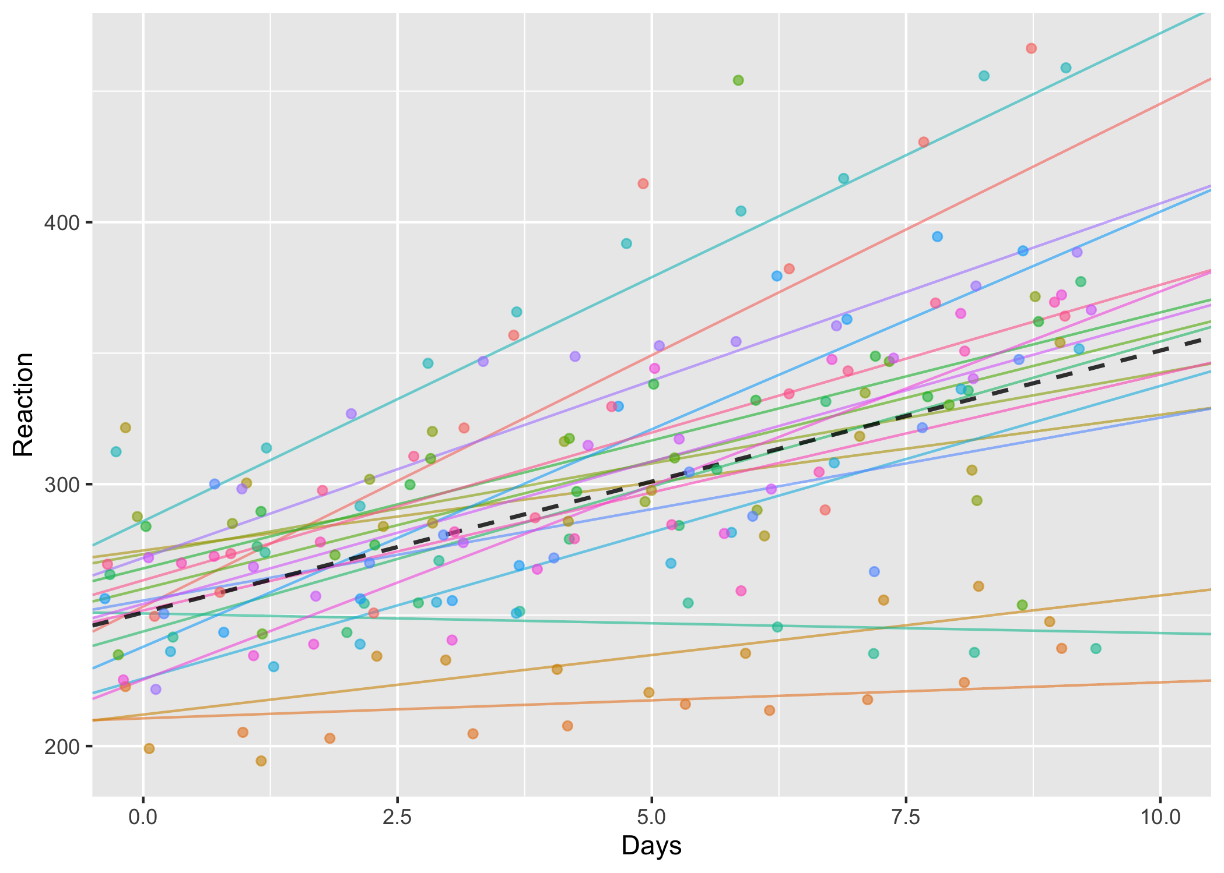

Slide 4
Questions
Is there substantial variation in the effect of sleep deprivation?
Is there substantial variation between subjects in reaction times on average?

Slide 5
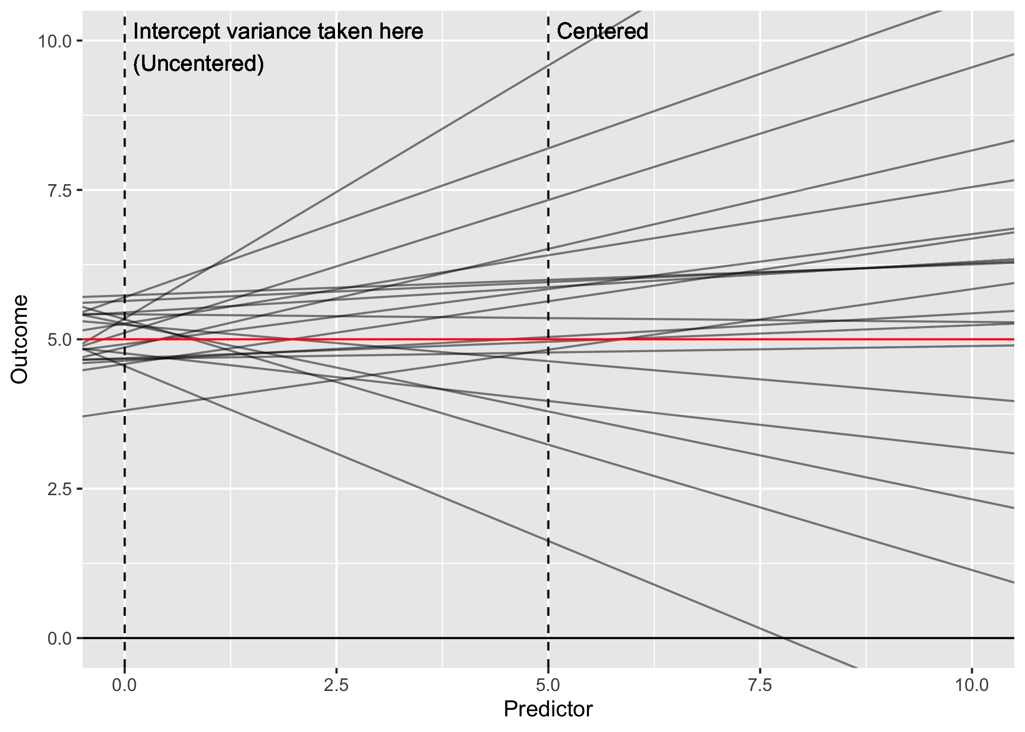

Slide 6
Why is this?
Model parameters are estimated so that you can read them as “the effect of X, when everything else is set to zero”
Same as for multiple regression (e.g. when including a continuous covariate)
Need to be careful because zero may not be a realistic value

Slide 7
Reaction ~ Days + (Days | Subject)

Slide 8
What to do?
Centering covariates (subtracting the mean) helps because it
Changes the interpretation of other paramaters…
Read as: “The effect of X2, at the average value of X1”
Why? Because we shifted zero so that zero = the average value

Slide 9
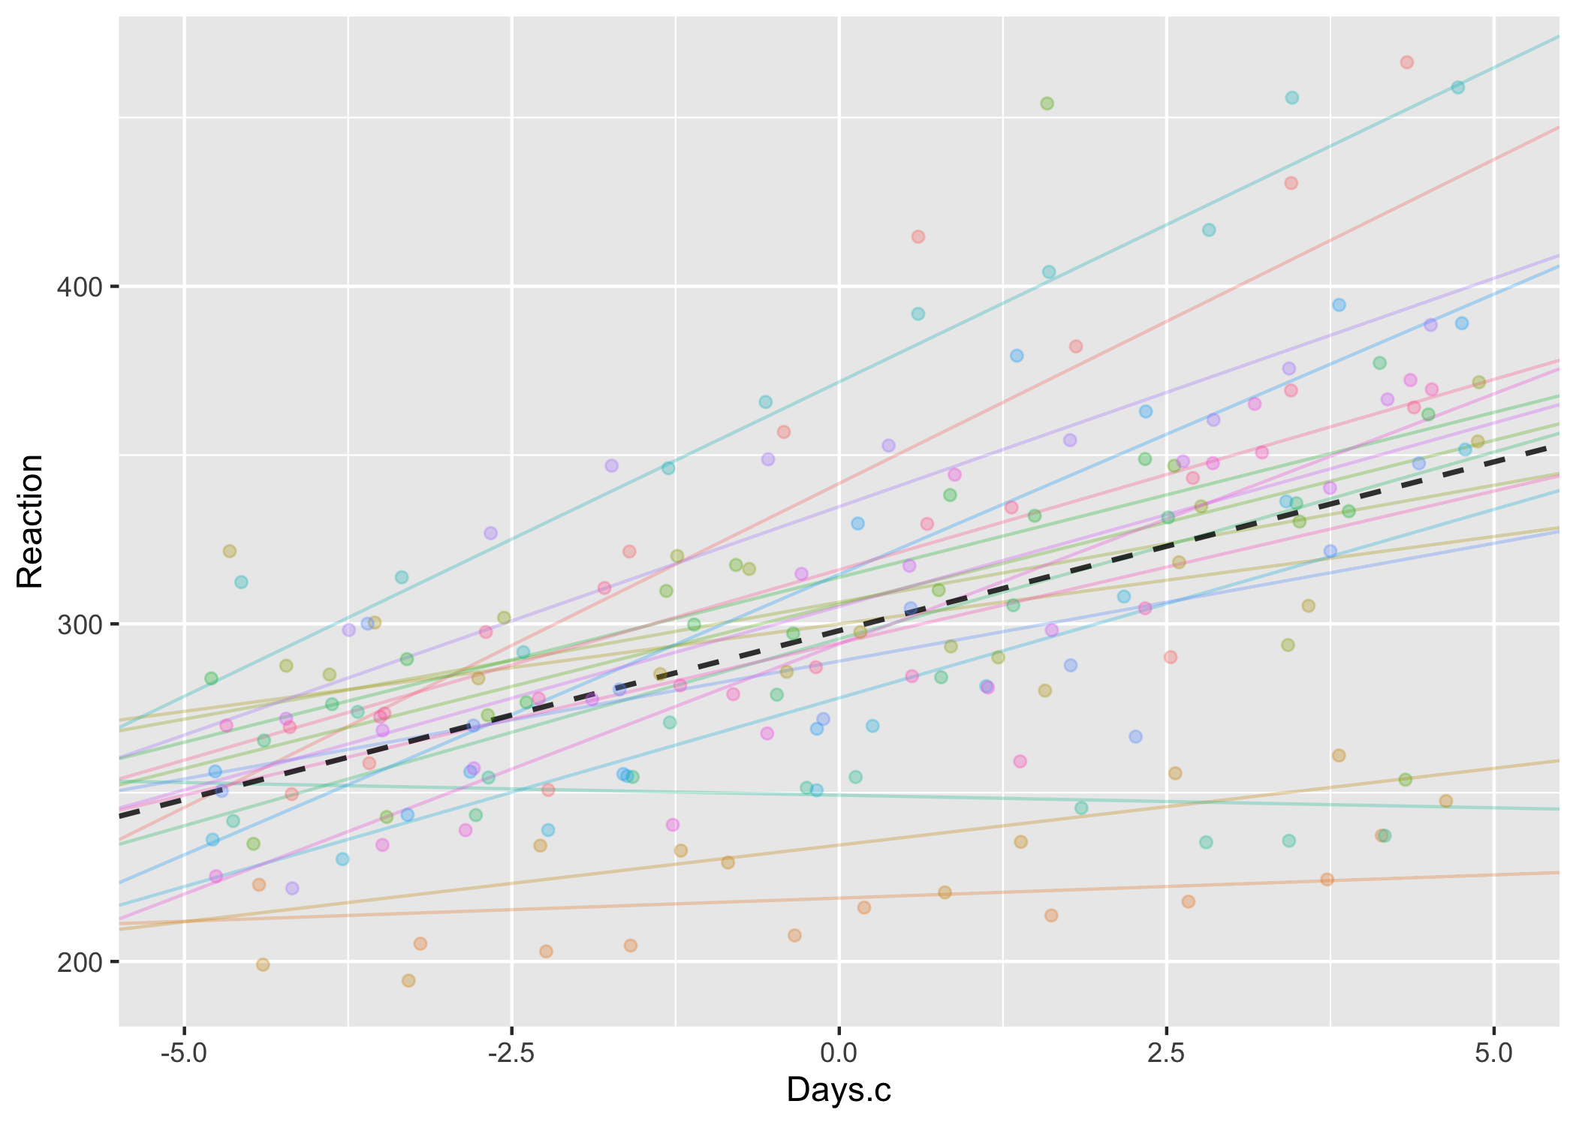
Reaction ~ Days.c + (Days.c | Subject)
sleepstudy %>%
mutate(Days.c = Days - mean(Days))

Slide 10
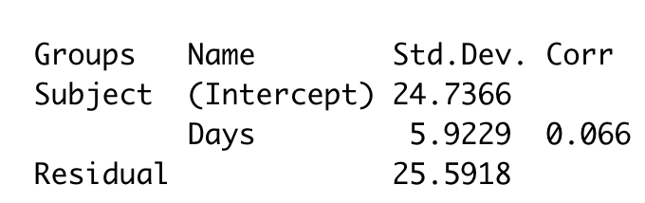
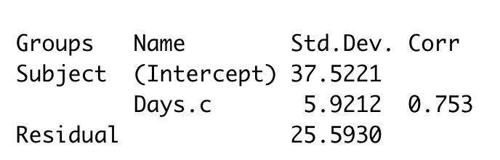


Uncentered/centered variances
Uncentered
Centered

Slide 11
Should everything be centered
Yes!
Probably safer (especially with interactions)
Usually easier to interpret
No!
Sometimes the covariate is on a meaningful scale
Might want to estimate between-variance when X=0 (e.g. at the start of the study)

Slide 12
How to center
cars.c <- mtcars %>%
mutate(wt.c = wt - mean(wt))
cars.c <- mtcars %>%
mutate_if(
is.numeric,
funs( scale(., scale=F) )
)

Slide 13
Two sources of variation
8 male/female speakers,
Say 7 phrases (scenario)
Phrase can be either polite or informal (attitude).
Pitch (frequency) of utterances is measured.
Idemaru, K., Winter, B., & Brown, L. (2015). The role of pitch in perceiving politeness in Korean. In International Conference of Phonetic Sciences, Glasgow.
http://www.bodowinter.com/tutorial/bw_LME_tutorial2.pdf

Slide 17
lmer(frequency ~ attitude + (1|subject) …

Slide 18
lmer(frequency ~ attitude +
(1|subject) +
(1|scenario) …

Slide 19
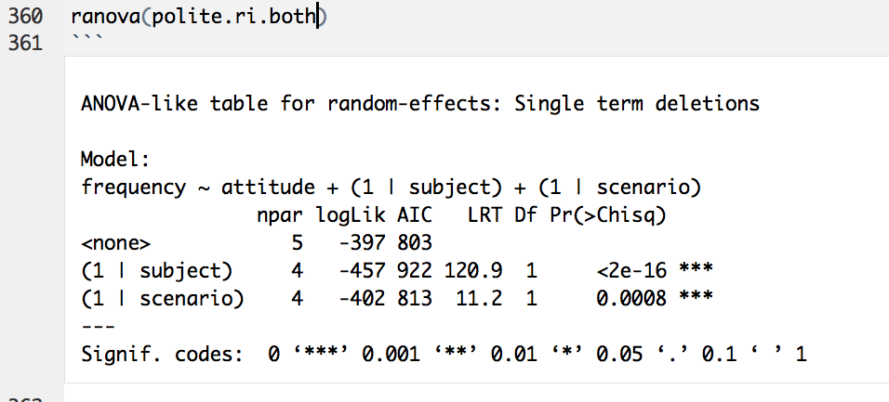

Slide 20
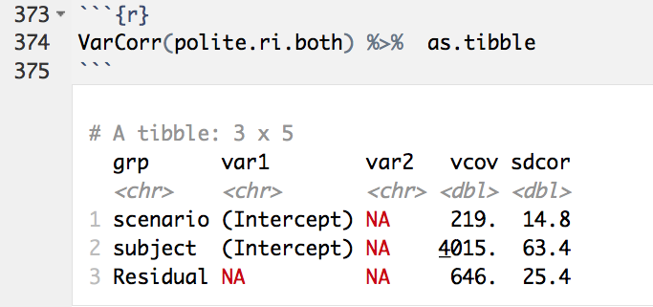
Notes:
Barr, D. J., Levy, R., Scheepers, C., & Tily, H. J. (2013). Random effects structure for confirmatory hypothesis testing: Keep it maximal. Journal of Memory and Language, 68(3), 255–278.

Slide 21
lmer(frequency ~ attitude +
(??|subject) +
(??|scenario) …

Slide 22
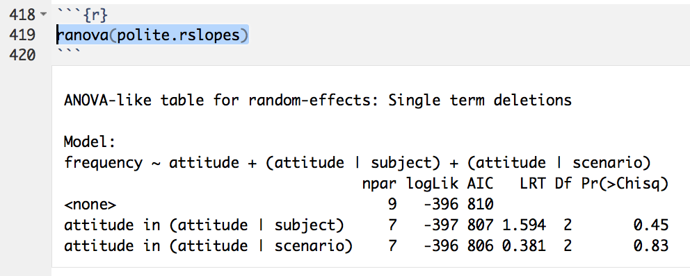
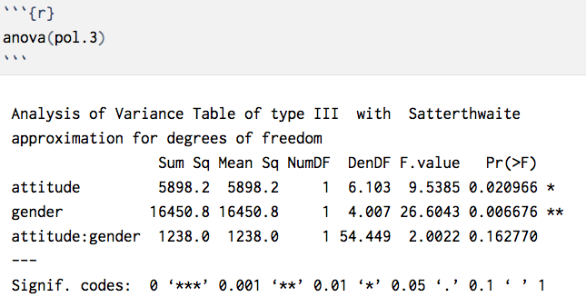
'Keep it maximal' (Barr 2013) (Maximal = More conservative)

Slide 23
If you can’t…
Exclude random effects parameter
lmer assumes correlated random effects by default…

Slide 24
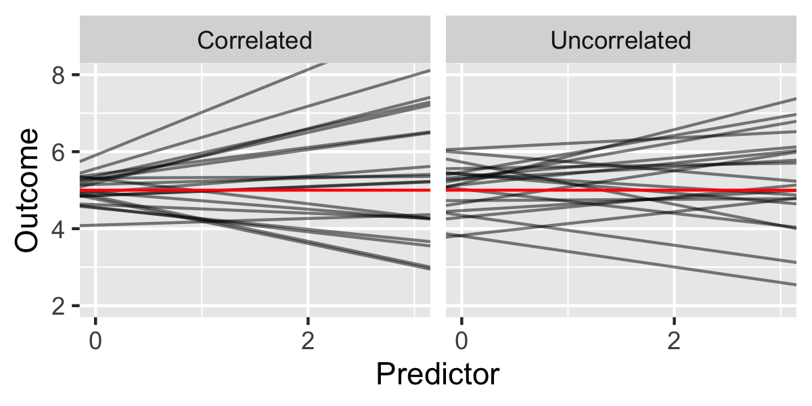

Slide 25
Correlated random effects
These often first to to be dropped when simplifying
Explicitly specifying the random intercept with (1|grouping)
Adding another term which is (0 + variable | grouping)
Reaction ~ Days + (1|Subject) + (0+Days|Subject)

Slide 26
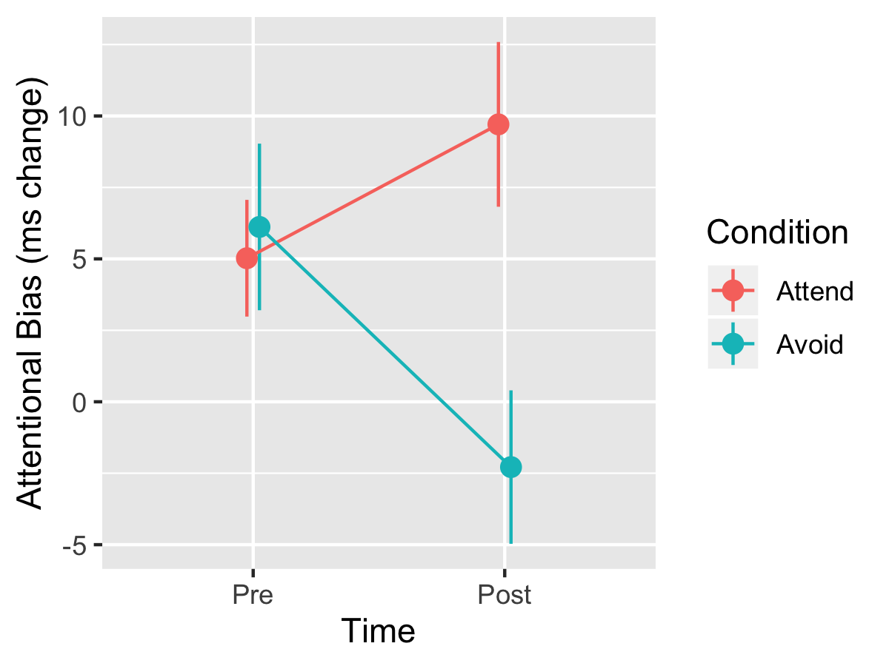
Tests and comparisons Attentional bias (dot probe) experiment
Notes:
https://journals.plos.org/plosone/article?id=10.1371/journal.pone.0226387#sec010
In the training phase, participants completed a modified dot probe task. Only the 16 critical (energy drink–soft drink) picture pairs were used. These were each presented 16 times, for a total of 256 trials, with each picture appearing 8 times on each side of the screen. To combat potential boredom or fatigue, participants were given a brief break halfway through the training. Attentional bias was manipulated by varying the location of the dot probes. In the attend condition, dot probes replaced energy drink pictures on 90% of trials and soft drink pictures on 10% of trials, designed to direct attention toward energy drink cues. Conversely, in the avoid condition, dot probes replaced energy drink pictures on 10% of trials and soft drink pictures on 90% of trials, designed to direct attention away from energy drink cues. A 90–10 distribution was used, as opposed to a 100–0 one, to reduce the obviousness of the contingency [29].

Slide 27
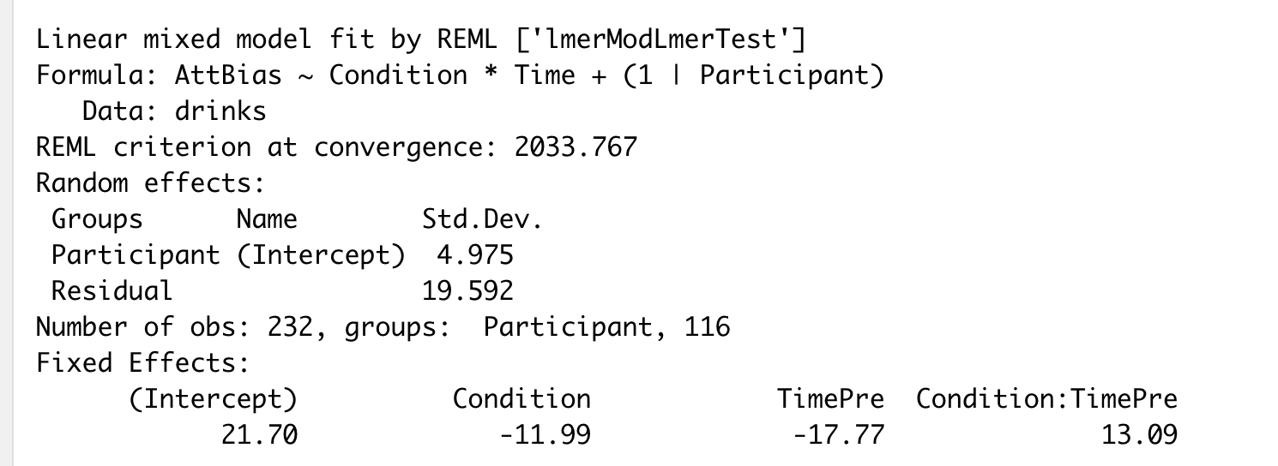
What kind of model is this?

Slide 28
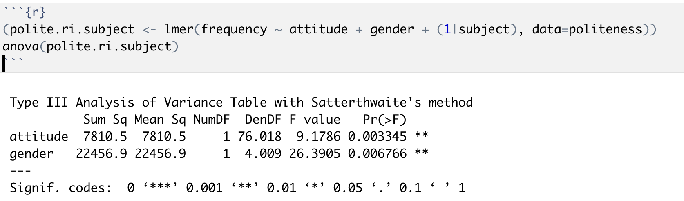
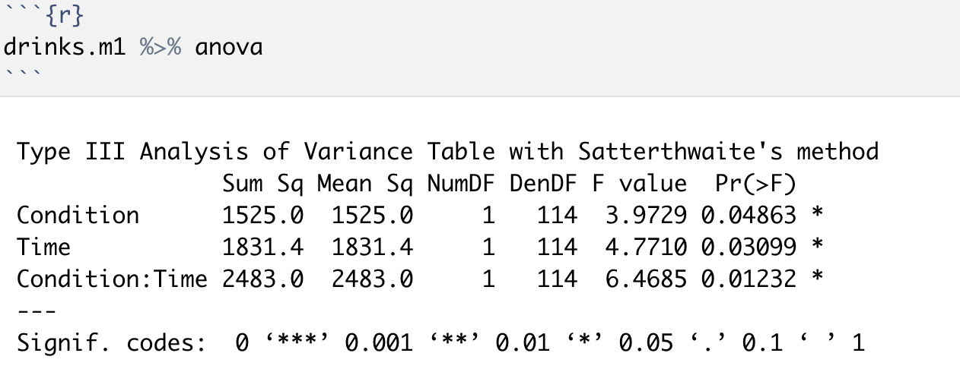

Anova degrees of freedom
Degrees of freedom are adjusted (Satterthwaite method) for the amount of clustering. You will sometimes see non-integer df values.

Slide 29
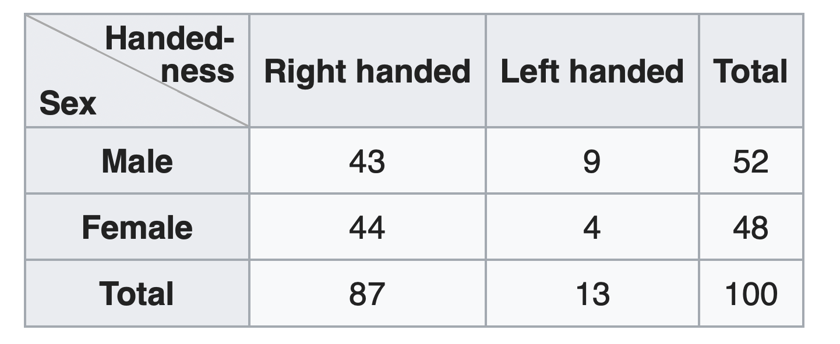
emmeans for followup tests emmeans = estimated marginal means marginal = “averaging across other factors”

Slide 30
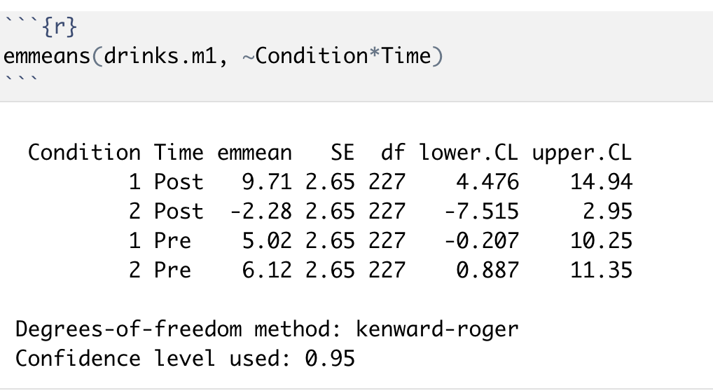
emmeans for followup tests emmeans = estimated marginal means marginal = “averaging across other factors”

Slide 31
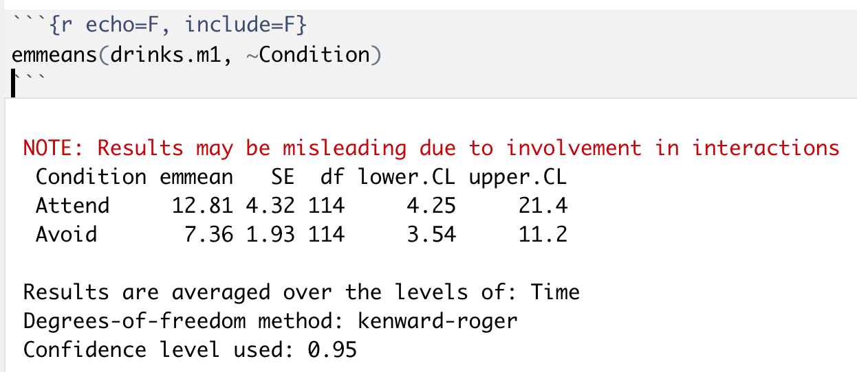
emmeans uses ‘right hand’ formulae

Slide 32
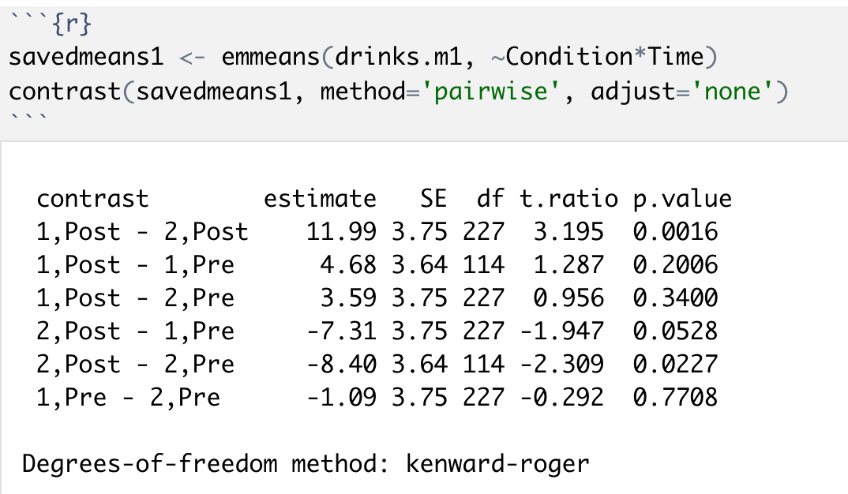
Pairwise contrasts

Slide 33
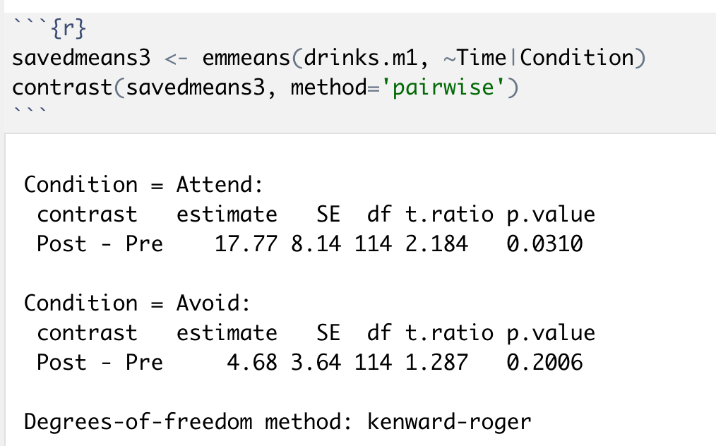

Specific contrasts
Means Time within Condition

